Slide 1
Foundation of Computer Science
Lecture 7
OVERVIEW OF SETS & SETS OPERATIONS

Slide 2
DEFINITION of Set
A set is an unordered collection of objects, called elements or members of the set. A set is
said to contain its elements.
We write a ∈ A to denote that a is an element of the set A. The

Slide 3
OVERVIEW OF SET
Sets are equal if and only if they have the same elements
Order and repetition don’t matter for sets
Note that a set doesn’t equal its elements, i.e. {a} ≠ a
Some Example of Sets
A set of all positive integers
A set of all the planets in the solar system
A set of all the states in India
A set of all the lowercase letters of the alphabet

Slide 4
Some Important Sets
N − the set of all natural numbers = {1,2,3,4,.....}
Z − the set of all integers = {.....,−3,−2,−1,0,1,2,3,.....}
Z+ − the set of all positive integers
Q − the set of all rational numbers
R − the set of all real numbers
W − the set of all whole numbers

Slide 5
Cardinality of a Set:- Size of set
Cardinality of a set S, denoted by |S|, is the number of elements of the set. The number is also referred as the cardinal number. If a set has an infinite number of elements, its cardinality is ∞.
Example − |{1,4,3,5}|=4,|{1,2,3,4,5,…}|=∞

Slide 6
Cardinality of a Set
If there are two sets X and Y,
|X|=|Y| denotes two sets X and Y having same cardinality. It occurs when the number of elements in X is exactly equal to the number of elements in Y. In this case, there exists a bijective function ‘f’ from X to Y.
|X|≤|Y| denotes that set X’s cardinality is less than or equal to set Y’s cardinality. It occurs when number of elements in X is less than or equal to that of Y. Here, there exists an injective function ‘f’ from X to Y.
|X|<|Y| denotes that set X’s cardinality is less than set Y’s cardinality. It occurs when number of elements in X is less than that of Y. Here, the function ‘f’ from X to Y is injective function but not bijective.
If |X|≤|Y| and |X|≥|Y| then |X|=|Y|. The sets X and Y are commonly referred as equivalent sets.

Slide 7
Types of sets
Sets can be classified into many types. Some of which are finite, infinite, subset, universal, proper, singleton set, etc.
1. Finite Set
A set which contains a definite number of elements is called a finite set.
Example − S={x |x ∈ N and 70>x>50}
2. Infinite Set
A set which contains infinite number of elements is called an infinite set.
Example − S={x |x ∈ N and x>10}
3. Subset
A set X is a subset of set Y (Written as X⊆Y) if every element of X is an element of set Y.
Example 1 − Let, X={1,2,3,4,5,6} and Y={1,2}. Here set Y is a subset of set X as all the elements of set Y is in set X. Hence, we can write Y⊆X.
Example 2 − Let, X={1,2,3} and Y={1,2,3}. Here set Y is a subset (Not a proper subset) of set X as all the elements of set Y is in set X. Hence, we can write Y⊆X.

Slide 8
Types of Set
4. Proper Subset
The term “proper subset” can be defined as “subset of but not equal to”. A Set X is a proper subset of set Y (Written as X⊂Y) if every element of X is an element of set Y and |X|<|Y|.
Example − Let, X={1,2,3,4,5,6} and Y={1,2}. Here set Y⊂X since all elements in Y are contained in X too and X has at least one element is more than set Y.
5. Universal Set
It is a collection of all elements in a particular context or application. All the sets in that context or application are essentially subsets of this universal set. Universal sets are represented as U.
Example − We may define U as the set of all animals on earth. In this case, set of all mammals is a subset of U, set of all fishes is a subset of U, set of all insects is a subset of U, and so on.
6. Empty Set or Null Set
An empty set contains no elements. It is denoted by ∅. As the number of elements in an empty set is finite, empty set is a finite set. The cardinality of empty set or null set is zero.
Example − S={x|x∈N and 7<x<8}=∅

Slide 9
Types of set
7. Singleton Set or Unit Set
Singleton set or unit set contains only one element. A singleton set is denoted by {s}.
Example − S={x|x∈N, 7<x<9} = {8}
8. Equal Set
If two sets contain the same elements they are said to be equal.
Example − If A={1,2,6} and B={6,1,2}, they are equal as every element of set A is an element of set B and every element of set B is an element of set A.
9. Equivalent Set
If the cardinalities of two sets are same, they are called equivalent sets.
Example − If A={1,2,6} and B={16,17,22}, they are equivalent as cardinality of A is equal to the cardinality of B. i.e. |A|=|B|=3

Slide 10
Types of set
10. Overlapping Set
Two sets that have at least one common element are called overlapping sets.
In case of overlapping sets −
n(A∪B)=n(A)+n(B)−n(A∩B)
n(A∪B)=n(A−B)+n(B−A)+n(A∩B)
n(A)=n(A−B)+n(A∩B)
n(B)=n(B−A)+n(A∩B)
Example − Let, A={1,2,6} and B={6,12,42}. There is a common element ‘6’, hence these sets are overlapping sets.
11. Disjoint Set
Two sets A and B are called disjoint sets if they do not have even one element in common. Therefore, disjoint sets have the following properties −
n(A∩B)=∅
n(A∪B)=n(A)+n(B)
Example − Let, A={1,2,6} and B={7,9,14}, there is not a single common element, hence these sets are overlapping sets.

Slide 11
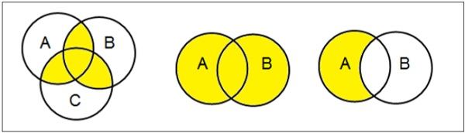
Venn Diagrams
Venn diagram, invented in 1880 by John Venn, is a schematic diagram that shows all possible logical relations between different mathematical sets.
Examples
Venn Diagram : -

Slide 12

Set Operations
Set Operations include Set Union, Set Intersection, Set Difference, Complement of Set, and Cartesian Product.
(i) Set Union
The union of sets A and B (denoted by A∪B) is the set of elements which are in A, in B, or in both A and B. Hence, A∪B={x|x∈A OR x∈B}.
Example − If A={10,11,12,13} and B = {13,14,15}, then A∪B={10,11,12,13,14,15}. (The common element occurs only once)

Slide 13
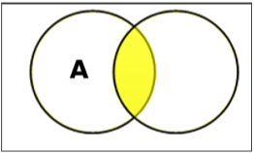
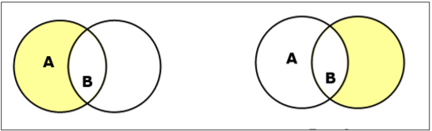
Set Operations
(ii) Set Intersection
The intersection of sets A and B (denoted by A∩B) is the set of elements which are in both A and B. Hence, A∩B={x|x∈A AND x∈B}.
Example − If A={11,12,13} and B={13,14,15}, then A∩B={13}.
(iii) Set Difference/ Relative Complement
The set difference of sets A and B (denoted by A–B) is the set of elements which are only in A but not in B. Hence, A−B={x|x∈A AND x∉B}.
Example − If A={10,11,12,13} and B={13,14,15}, then (A−B)={10,11,12} and (B−A)={14,15}. Here, we can see (A−B)≠(B−A)

Slide 14
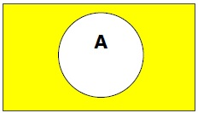
Set Operations
(iv) Complement of a Set
The complement of a set A (denoted by A′) is the set of elements which are not in set A. Hence, A′={x|x∉A}.
More specifically, A′=(U−A) where U is a universal set which contains all objects.
Example − If A={x|x belongs to set of odd integers} then A′={y|y does not belong to set of odd integers}

Slide 15
Set Operations
(v) Cartesian Product / Cross Product
The Cartesian product of n number of sets A1,A2,…An denoted as A1×A2⋯×An can be defined as all possible ordered pairs (x1,x2,…xn) where x1∈A1, x2∈A2, …xn∈An
Example − If we take two sets A={a,b} and B={1,2},
The Cartesian product of A and B is written as − A×B={(a,1),(a,2),(b,1),(b,2)}
The Cartesian product of B and A is written as − B×A={(1,a),(1,b),(2,a),(2,b)}
What is the Cartesian product of A = {1, 2} and B = {a, b, c}?

Slide 16
Power Set
Power set of a set S is the set of all subsets of S including the empty set. The cardinality of a power set of a set S of cardinality n is 2 raise to the power n. Power set is denoted as P(S).
Example −
For a set S={a,b,c,d} let us calculate the subsets −
Subsets with 0 elements − {∅} (the empty set)
Subsets with 1 element − {a},{b},{c},{d}
Subsets with 2 elements − {a,b},{a,c},{a,d},{b,c},{b,d},{c,d}
Subsets with 3 elements − {a,b,c},{a,b,d},{a,c,d},{b,c,d}
Subsets with 4 elements − {a,b,c,d}
Hence, P(S)={{∅},{a},{b},{c},{d},{a,b},{a,c},{a,d},{b,c},{b,d},{c,d},{a,b,c},{a,b,d},{a,c,d},{b,c,d},{a,b,c,d}}
|P(S)|=2 to the power 4=16
Note − The power set of an empty set is also an empty set.
|P({∅})|=2 to the power 0=1 Cartesian Product / Cross Product

Slide 17
Power Set
What is the power set of the empty set?
What is the power set of the set {∅}?
What is the power set of the set {0, 1, 2}?

Slide 18
Partitioning of a Set
Partition of a set, say S, is a collection of n disjoint subsets, say P1,P2,…Pn that satisfies the following three conditions −
Pi does not contain the empty set.
[Pi≠{∅} for all 0<i≤n]
The union of the subsets must equal the entire original set.
[P1 ∪ P2 ∪⋯∪ Pn=S]
The intersection of any two distinct sets is empty.
[Pa∩Pb={∅}, for a≠b where n≥a,b≥0]
Example
Let S={a,b,c,d,e,f,g,h}
One probable partitioning is {a},{b,c,d},{e,f,g,h}
Another probable partitioning is {a,b},{c,d},{e,f,g,h}

Slide 19
Set Identities

Slide 20

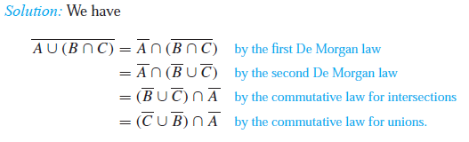

Slide 21


Slide 22

Law of duality
If E is an equation of set algebra then dual E* is obtained by replacing
U by
by U
∪ by ∩
∩ by ∪
Example: (U ∩ A) ∪( ∩ A^{c} )

Slide 23
Questions
1. Use Venn diagrams in different situations to find the following sets.
(a) A ∪ B
(b) A ∩ B
(c) A'
(d) B - A
(e) (A ∩ B)'
(f) (A ∪ B)'

Slide 24
QUESTIONS
2. Let A = {a, b, d, e}, B = {b, c, e, f} and C = {d, e, f, g}
(i) Verify A ∩ (B ∪ C) = (A ∩ B) ∪ (A ∩ C)
(ii) Verify A ∪ (B ∩ C) = (A ∪ B) ∩ (A ∪ C)
3. In a group of 60 people, 27 like cold drinks and 42 like hot drinks and each person likes at least one of the two drinks. How many like both coffee and tea?
4. There are 35 students in art class and 57 students in dance class. Find the number of students who are either in art class or in dance class.
5. In a competition, a school awarded medals in different categories. 36 medals in dance, 12 medals in dramatics and 18 medals in music. If these medals went to a total of 45 persons and only 4 persons got medals in all the three categories, how many received medals in exactly two of these categories?

Slide 25

Question

Slide 26
Thank You

